Slide 1


Slide 2
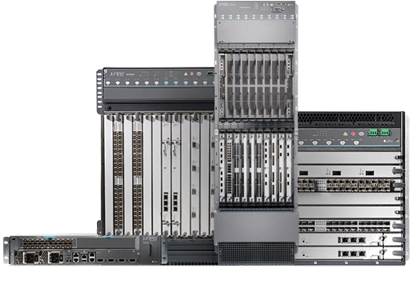
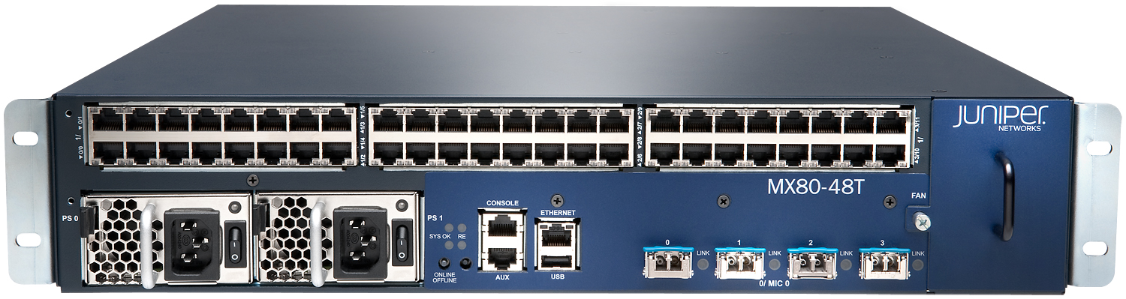
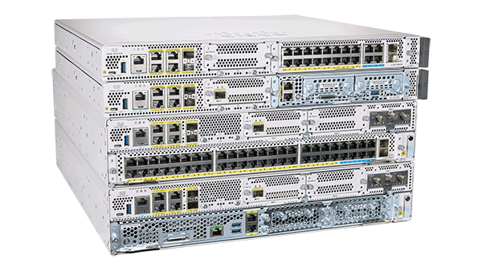
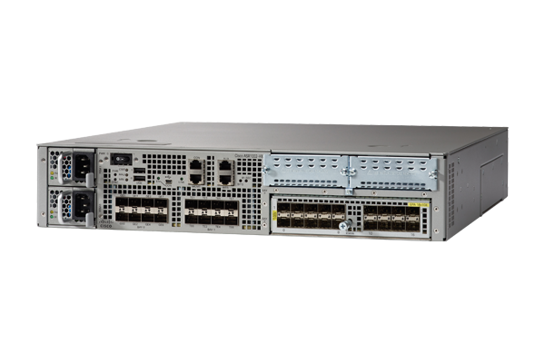
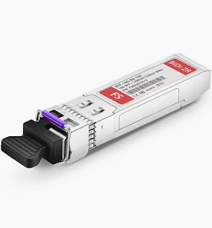



Routers: -Layer 3 devices

Slide 3
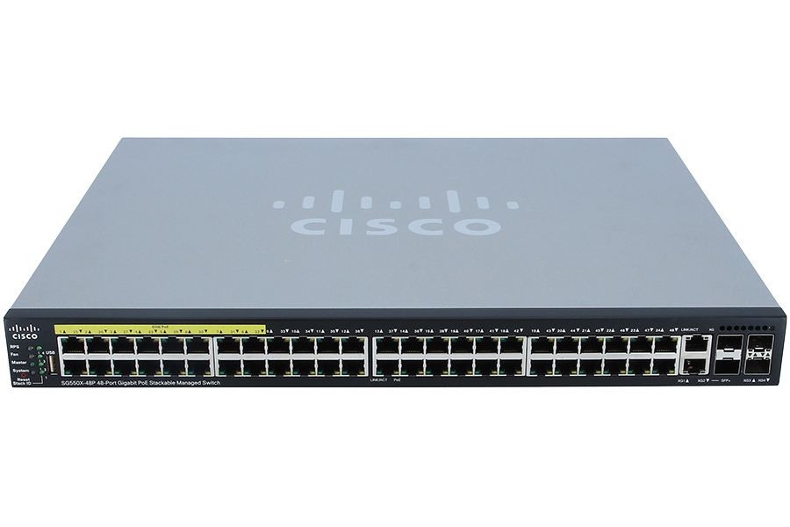
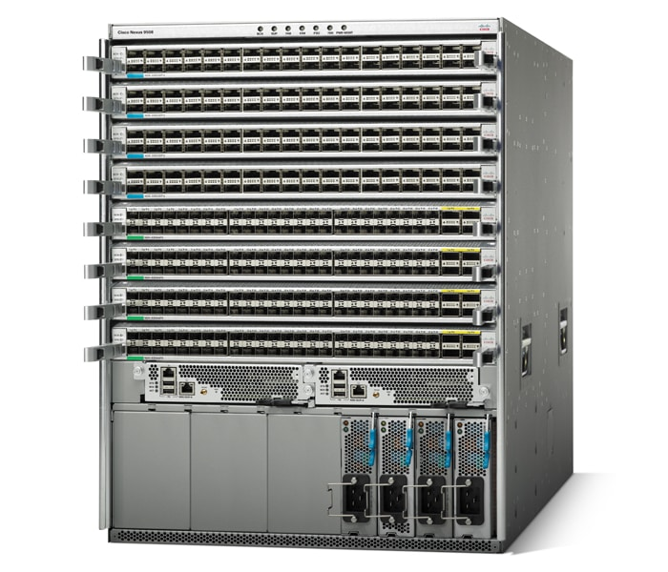
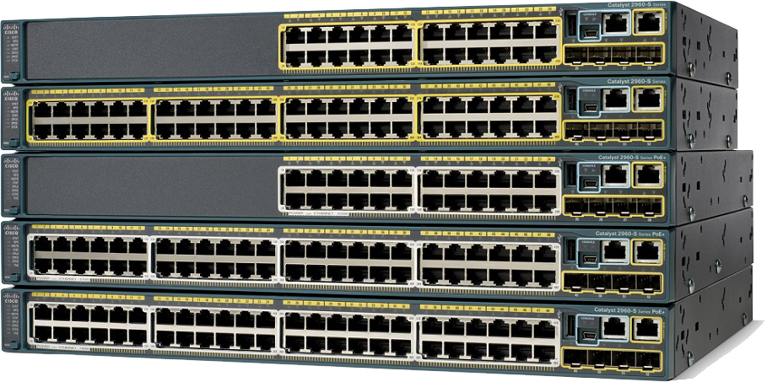

Switches

Slide 4
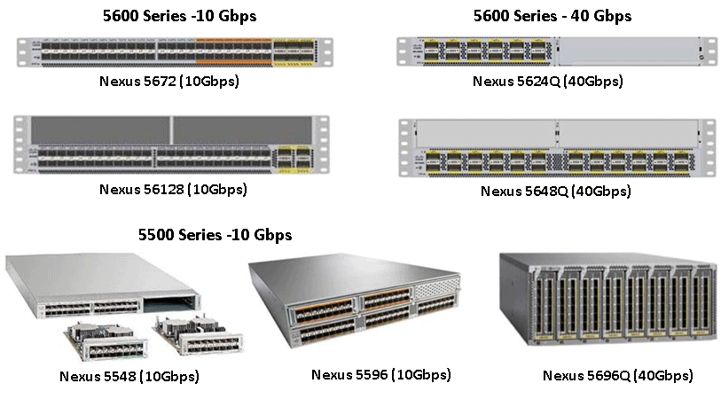



Slide 5
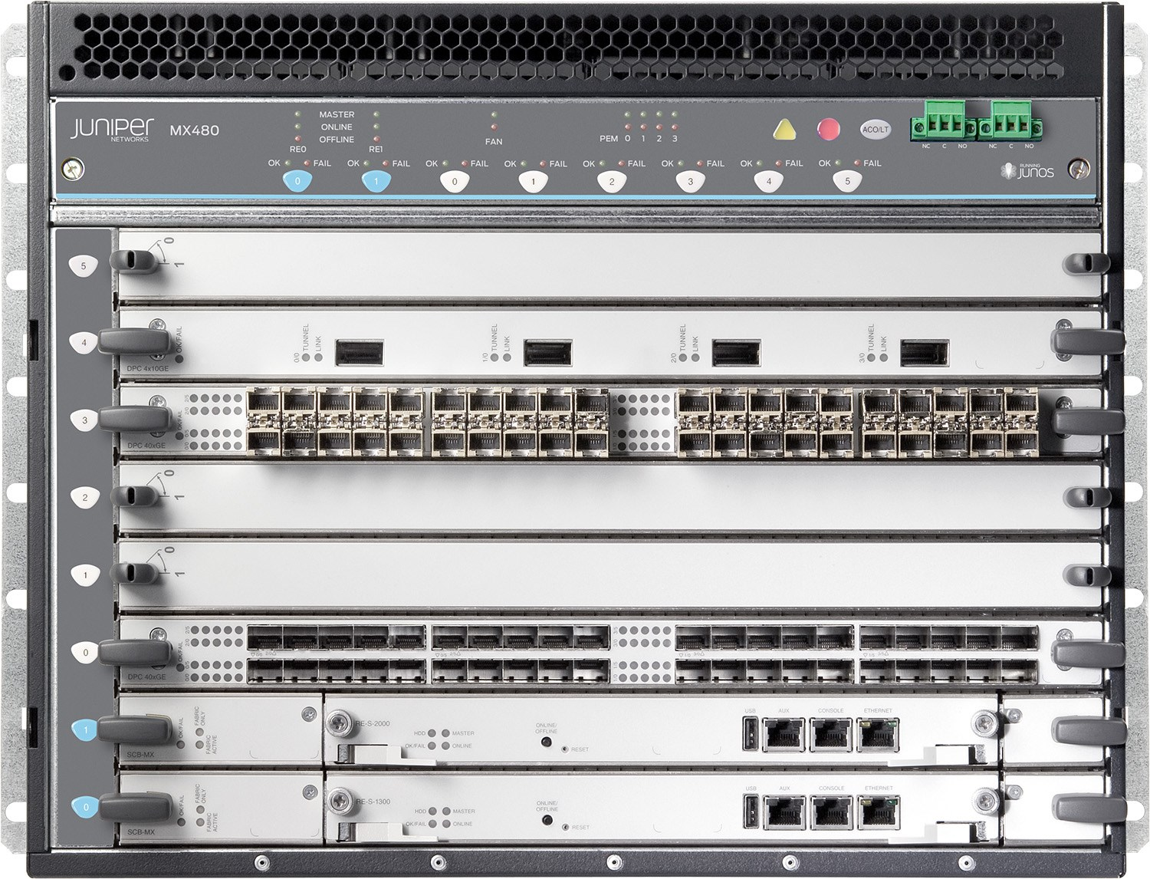


Slide 6
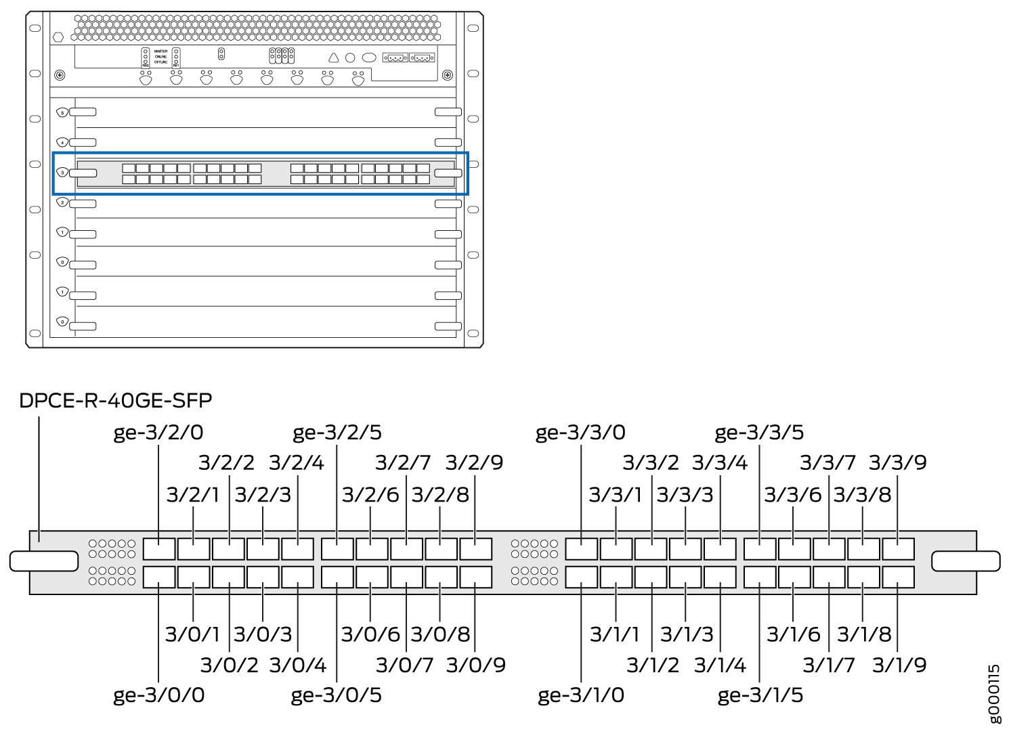
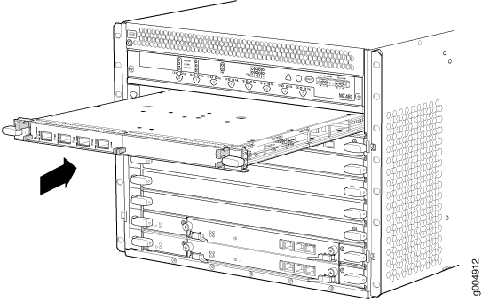


Slide 7
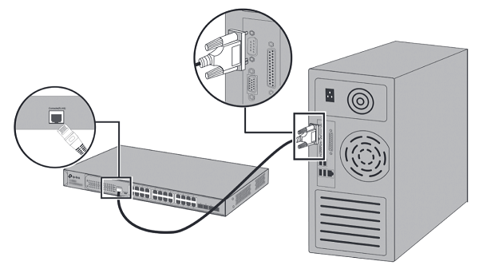
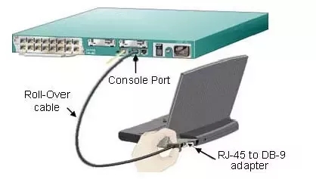
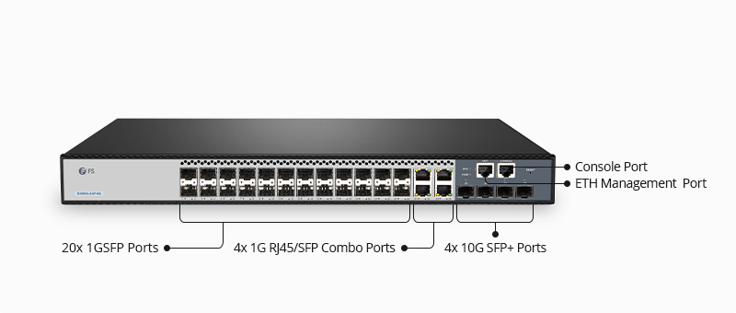
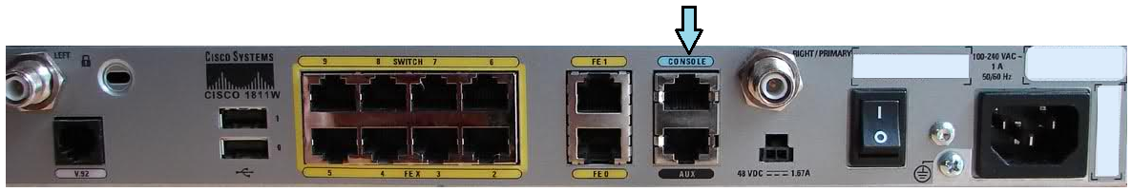
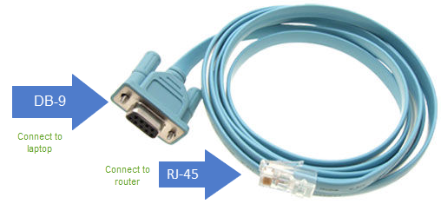
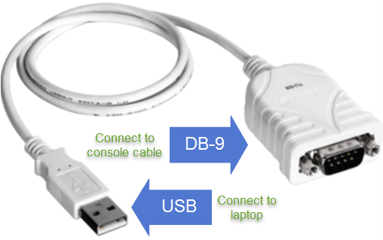
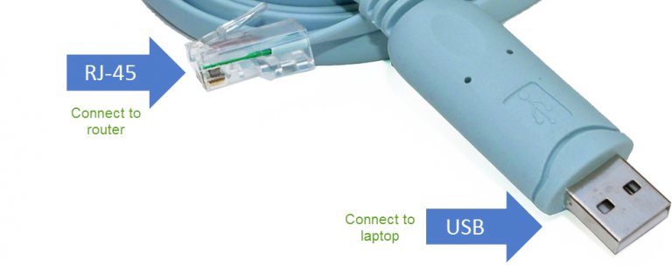


Slide 9
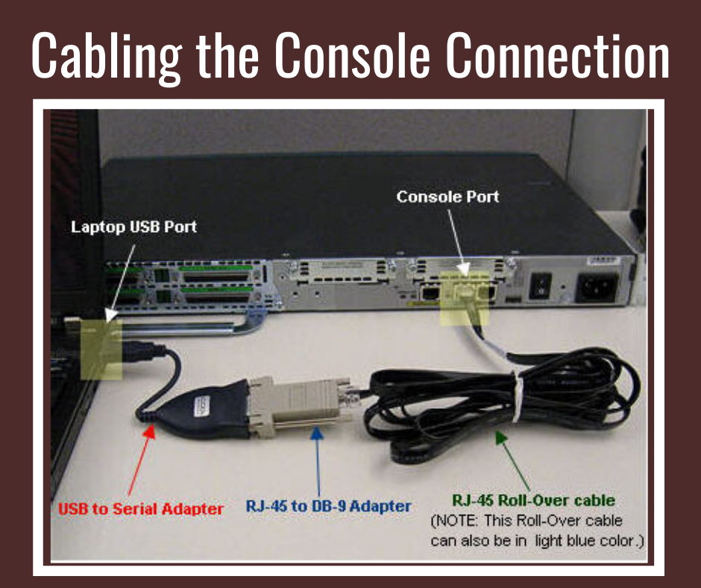

Slide 10
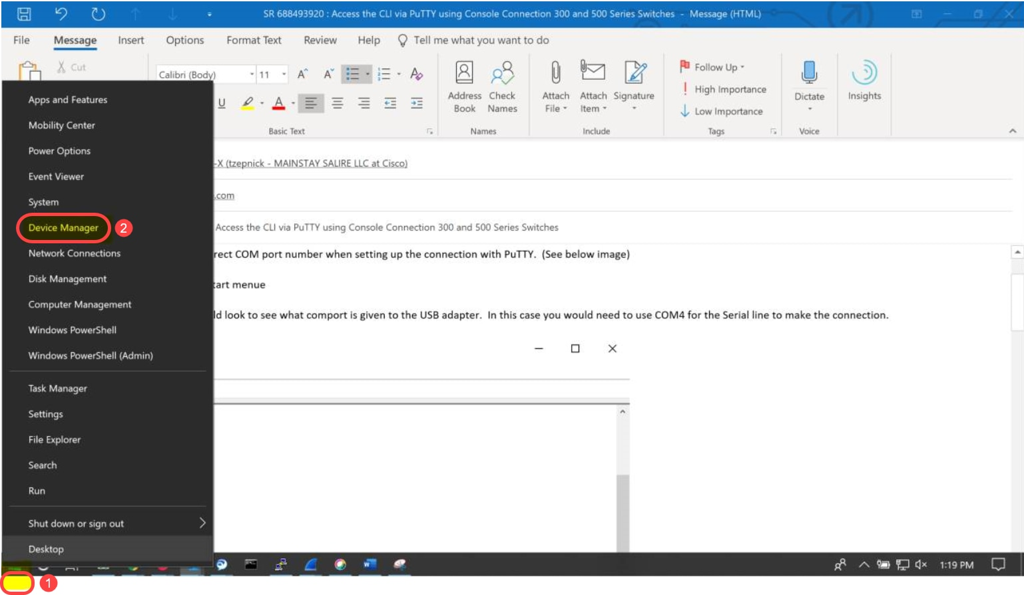
Right-click on the Windows logo/Start menu and click on Device Manager to open it.

Slide 11
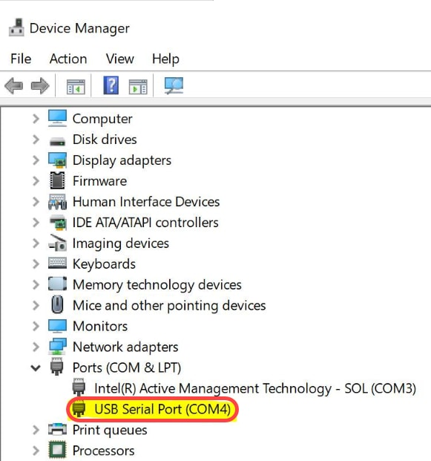

Slide 12
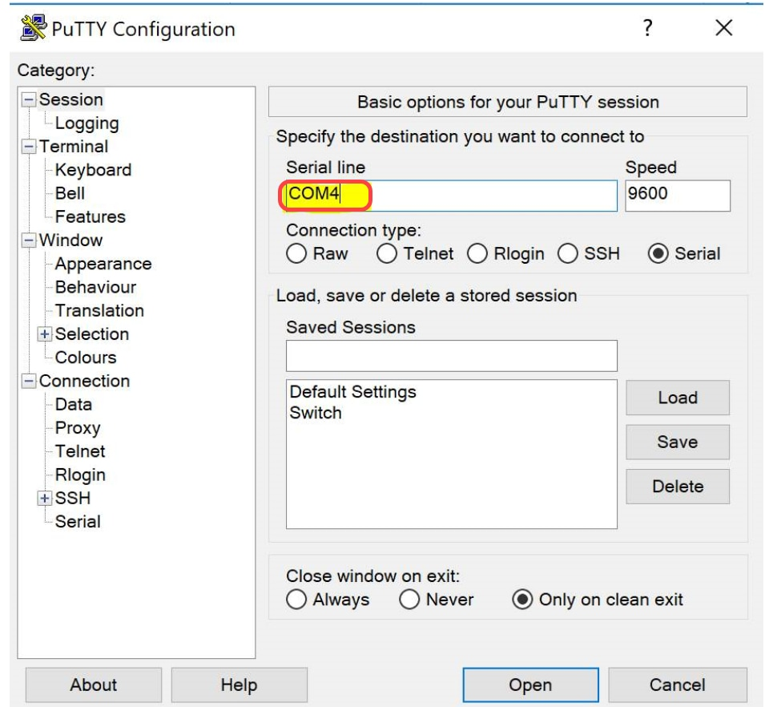

Slide 13
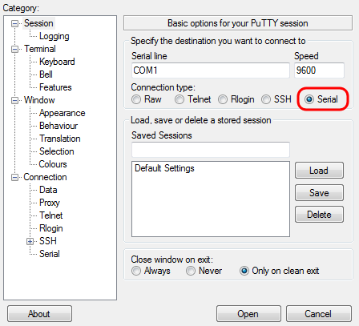
Login to the Router/Switch through console
A computer with PuTTY installed. Download PuTTY from below link https://www.chiark.greenend.org.uk/~sgtatham/putty/latest.html?trk=article-ssr-frontend-pulse_little-text-block
If your pc is 64 bit x86 Architecture download this 64-bit x86: putty-64bit-0.81-installer.msi
If your PC is 32-bit x86: download this putty-0.81-installer.msi
Step 2: Establish a Connection 🔌
Connect the console cable to the router's console port and then to your computer. No serial port on your computer? No problem! You'll need a USB-to-serial adapter.
Open PuTTY.
Select 'Serial' in the 'Category' list.
Adjust the serial line to match your connection port with '9600' baud as your speed (check your device manager for COM Port assignments).
Click 'Open' to initiate the connection.

Slide 14
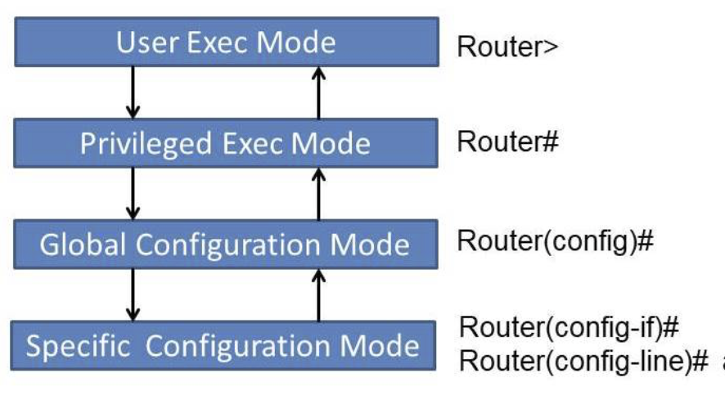
Step 3: Accessing the Router 🖥️
Power on your Cisco router. After a moment, you should see the initial configuration dialog in the PuTTY terminal.
If prompted to enter the initial configuration, type 'no' and press 'Enter.' We’re going the manual route! 💪
Step 4: Enter Global Configuration Mode ⚙️
Type 'enable' to go into privileged EXEC mode. It may ask for a password, depending on previous setups.
Once you see the '#' prompt, type 'configure terminal' or 'conf t' to get into the nitty-gritty of global configuration mode.
Step 5: Configure Basic Settings 🛡️ Now for some basic housekeeping:
Set a friendly hostname by typing 'hostname [DesiredHostName]' (e.g., 'hostname MyRouter').
Secure privileged mode with 'enable secret [YourStrongPassword]'.
Configure console access with a password to keep things secure: a. 'line con 0' takes you to the console line configuration. b. 'password [YourConsolePassword]' because security matters! c. 'login' to enforce that security. d. 'exit' to step back to the main configuration mode.
Step 6: Configure Interfaces 💻 Here, we’ll assign IP addresses and enable router interfaces.
Syntax: Hostname <anyname>
Syntax: Interface <interface name>

